Slide 1


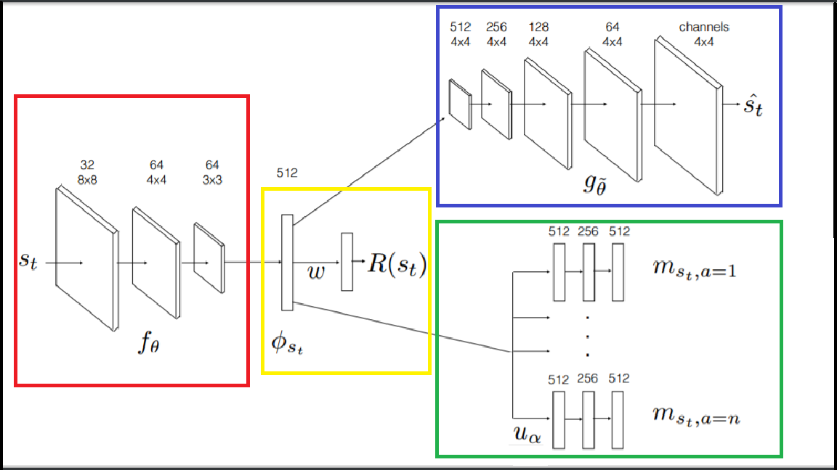
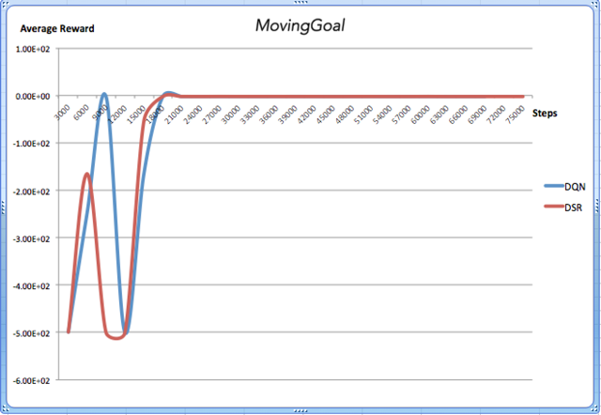
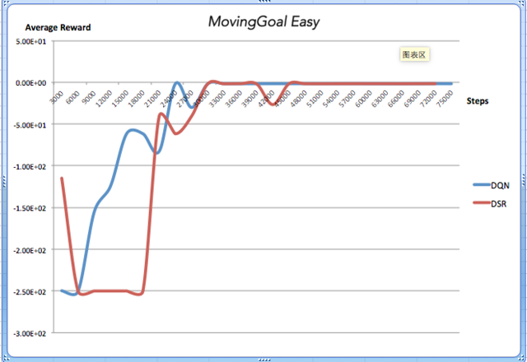
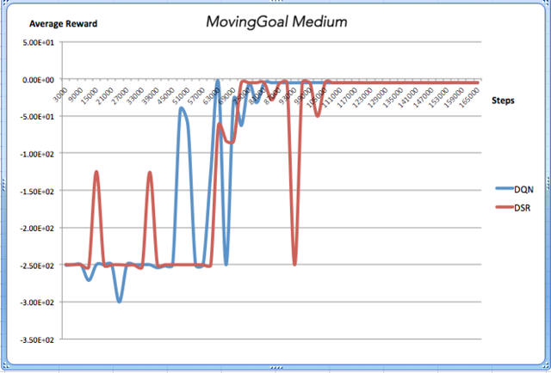
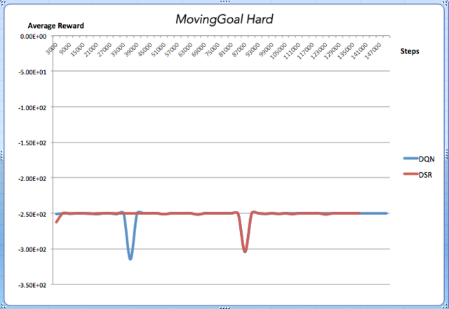
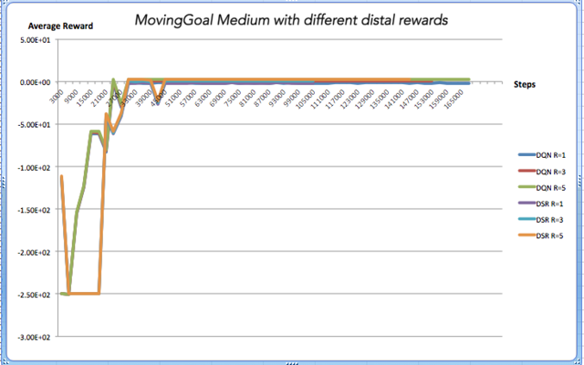
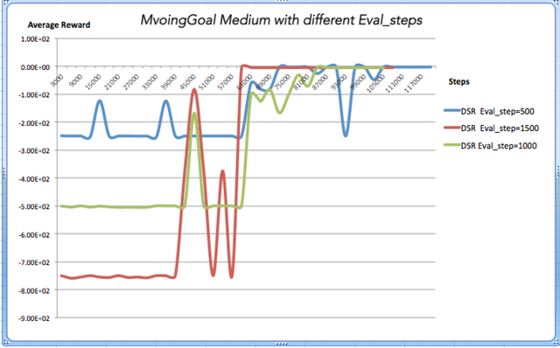
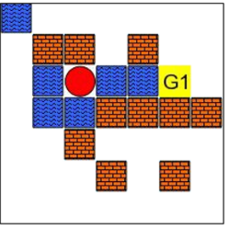
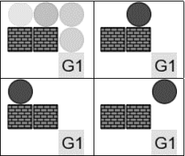
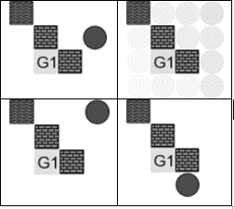

Deep Successor Reinforcement Learning for Maze Navigation
Nitin Kishore Sai Samala, Wenchao Wang, Xingjian Chen
UNIVERSTY OF MASSACHUSETTS AMHERST
Introduction
Model Architecture
DSR vs DQN
Many learning problems involve inferring properties of temporally extended sequences given an objective function. For instance, in reinforcement learning (RL), the task is to find a policy that maximizes expected future discounted rewards (value). RL algorithms fall into two main classes:
(1) model-free algorithms that learn cached value functions directly from sample trajectories, and (2) model-based algorithms that estimate transition and reward functions, from which values can be computed using tree-search or dynamic programming.
There is a third alternative called Successor Representation (SR)- which decomposes the value function into two components – a reward predictor and a successor map. The successor map represents the expected future state occupancy from any given state and the reward predictor maps states to scalar rewards. It combines computational efficiency comparable to model-free algorithms with some of the flexibility of model-based algorithms.
Why SR?
Generalizing SR within an end-to-end deep reinforcement learning framework has several appealing properties including:
Increased sensitivity to distal reward changes due to factorization of reward and world dynamics
Ability to extract bottleneck states (subgoals) given successor maps trained under a random policy.
Learning goal-directed behavior with sparse rewards is a fundamental challenge for existing reinforcement learning algorithms. The DSR can enable efficient exploration by periodically extracting subgoals, learning policies to satisfy these intrinsic goals (skills), and subsequently learning hierarchical policy over these subgoals in an options framework. Subgoal extraction scheme can be run periodically within a hierarchical reinforcement learning framework to aid exploration
Math Involved
MazeBase, A Grid-world domain
Background:
Consider an MDP with a set of states S, set of actions A, reward function R:S->Real Numbers, discount factor γ, and a transition distribution T:S×A -> [0,1], the Q-value function for selecting action a in state s is defined as the expected future discounted return. The agent’s goal is to find the optimal policy Q* which follows the Bellman equation.
$$Q^{∗}\left(s,a\right)=R\left(s_{t}\right)+γ\max_{a′}{E(Q(s_{t+1},a′))}$$
The successor representation:
SR is defined as the expected discounted future state occupancy:
$$M\left(s,s^{′},a\right)=E[\sum_{t=0}^{∞}{γ^{t}1\left[s_{t}=s^{′}\right]|s_{0}=s,a_{0}=a}]$$
where 1[:] = 1 when its argument is true and zero otherwise. This implicitly captures the state
visitation count. we can express the SR in a recursive form:
$$M\left(s,s^{′},a\right)=1\left[s_{t}=s′\right]+γE[M(s_{t+1},s^{′},a_{t+1})]$$
The Q-value for selecting action a in state s can be expressed as the inner product of
the immediate reward and the SR:
$$Q^{π}\left(s,a\right)=\sum_{s′∈S}{M(s,s^{′},a)R(s′)}$$
Deep successor representation:
$$Q^{π}(s, a) ≈ m_{sa} · w$$
The SR for the optimal policy in the non-linear function approximation case can then be obtained from the following Bellman equation:
$$m_{sa}= φ_{s}+ γE [m_{s_{t+1}a′}]$$
where $a^{′}={argmax}_{a}u_{a}(φ_{s_{t+1}}, a) · w$
Learning:
The parameters $(θ, α, w, \hat{θ})$ can be learned online through stochastic gradient descent.
The loss function for α is given by:
$$L_{t}^{m}\left(α, θ\right)=E[φ\left(s_{t}\right)+γu_{α_{prev}}(φ\left(s_{t+1},α^{′}\right)−u_{α}(φ\left(s_{t},α\right))]$$
where $a^{′}={argmax}_{a}u_{a}(φ_{s_{t+1}}, a) · w$ and the parameter $α_{prev}$ denotes a previously cached parameter value, set periodically to α. This is essential for stable Q-learning with function approximations.
For learning w, the weights for the reward approximation function,
$$L_{t}^{r}(w, θ) ={(R(s_{t}) − φ_{s_{t}}·w)}^{2}$$
Parameter θ is used for obtaining the φ(s), the shared feature representation for both reward prediction and SR approximation. An ideal φ(s) should be: 1) a good predictor for the immediate reward for that state and 2) a good discriminator for the states. The first condition can be handled by minimizing loss function $L_{t}^{r}$ ; however, we also need a loss function to help in the second condition. To this end, we use a deep convolutional auto-encoder to reconstruct images under an L2 loss function. This dense feedback signal can be interpreted as an intrinsic reward function. The loss function can be stated as:
$$L_{t}^{a}(\hat{θ}, θ)={(g_{\hat{θ}}\left(φ_{s_{t}}\right)−s_{t})}^{2}$$
The composite loss function is the sum of the three loss functions given above:
$$L_{t}\left(θ, α, w, \hat{θ}\right)=L_{t}^{m}\left(α, θ\right)+L_{t}^{r}\left(w, θ\right)+L_{t}^{a}(\hat{θ}, θ)$$
Sub-goal Extraction
Conclusions
Subgoals are states which separate different partitions of the environments under the normalized-cut algorithm. One inherent limitation of this approach is that due to the random policy, the subgoal candidates are often quite noisy. Given a random policy, we train DSR until convergence and collect a large number of sample transitions and their corresponding successor representations.Applying a normalized cut-based algorithm on the SRs we obtained a partition of the environment as well as the bottleneck states (which correspond to goals). Additionally, this subgoal extraction algorithm is non-parametric and can handle flexible number of subgoals.
We presented the DSR, a novel deep reinforcement learning framework to learn goal-directed behavior given raw sensory observations.
It converges faster than DQN and gives better results for greater distal rewards.
The SR has been used in neuroscience as a model for describing different cognitive phenomena and is interpreted as an attractor network in a low–dimensional space.
If the network is stimulated with a goal location it can generate a path to the goal and is a suggested a model for tying the problems of navigation and reward maximization in the brain.
The factorization of the value function gives rise to several appealing properties over existing deep reinforcement learning methods.
Environment:
Each game is played in a 2D rectangular grid. Each location in the grid can be empty, or may contain one or more items such as:
Block: an impassible obstacle that does not allow the agent to move to that grid location
Water: the agent may move to a grid location with water, but incurs an additional cost of for doing so.
Switch: a switch can be in one of M states, which we refer to as colors. The agent can toggle through the states cyclically by a toggle action when it is at the location of the switch .
Door: a door has a color, matched to a particular switch. The agent may only move to the door’s grid location if the state of the switch matches the state of the door.
Pushable-Block: This block is impassable, but can be moved with a separate “push” actions. The block moves in the direction of the push, and the agent must be located adjacent to the block opposite the direction of the push.
Corner: This item simply marks a corner of the board.
Goal: depending on the game, one or more goals may exist, each named individually.
Info: these items do not have a grid location, but can specify a or give information necessary for its completion.
The environment is presented to the agent as a raw pixel observation, each describing an item in the game. The environments are generated randomly with some distribution on the various items. For example, we usually specify a uniform distribution over height and width, and a percentage of wall blocks and water blocks. Four the purpose of our project we limited the tasks to four levels of difficulty:
Moving Goals,
Moving Goals Easy,
Moving Goals Medium,
Moving Goals Hard
The agent starts at an arbitrary location and needs to get to the goal state. The agent gets penalty of -0.5 per-step, -1 to step on the water-block (blue) and +1 for reaching the goal state. The model observes raw pixel images during learning.
Bibliography
[1] Andrew G Barto and Sridhar Mahadevan. Recent advances in hierarchical reinforcement learning. Discrete Event Dynamic Systems, 13(4):341–379, 2003.
[2] Dane S Corneil and Wulfram Gerstner. Attractor network dynamics enable preplay and rapid path planning in maze–like environments. In Advances in Neural Information Processing Systems, pages 1675–1683, 2015.
[3] Nathaniel D Daw and Peter Dayan. The algorithmic anatomy of model-based evaluation. Philosophical Transactions of the Royal Society of London B: Biological Sciences, 369(1655):20130478, 2014.
[4] Tejas D. Kulkarni, Ardavan Saeedi, Simanta Gautam, Deep Successor Reinforcement Learning. arXiv preprint arXiv:1606.02396v1[stat.ML], 2016.
[5] Peter Dayan. Improving generalization for temporal difference learning: The successor representation. Neural Computation, 5(4):613–624, 1993.
[6] Sandeep Goel and Manfred Huber. Subgoal discovery for hierarchical reinforcement learning using learned policies. In FLAIRS conference, pages 346–350, 2003.
[7] Klaus Greff, Rupesh Kumar Srivastava, and Jürgen Schmidhuber. Binding via reconstruction clustering. arXiv preprint arXiv:1511.06418, 2015.
[8] Karol Gregor, Ivo Danihelka, Alex Graves, and Daan Wierstra. Draw: A recurrent neural network for image generation. arXiv preprint arXiv:1502.04623, 2015.
[9] Tejas D. Kulkarni, Ardavan Saeedi, Simanta Gautam, and Samuel J. Gershman. Deep successor reinforcement learning. arXiv:1606.02396, 2016b.

